Slide 1

Unit-2 Process and Threads Management
Operating System (OS)
2301CS601
Prof. Firoz A Sherasiya
Computer Engineering Department
firoz.sherasiya@darshan.ac.in
9879879861

Slide 2

Looping
Outline (Processes)
Process concept
Process states
Process state transitions
Process Control Block (PCB)
Context switching
Threads
Comparison between process and thread
Benefits/Advantages of threads
Types of threads
Multi Threading Models

Slide 3
Process concept
Section - 1

Slide 4
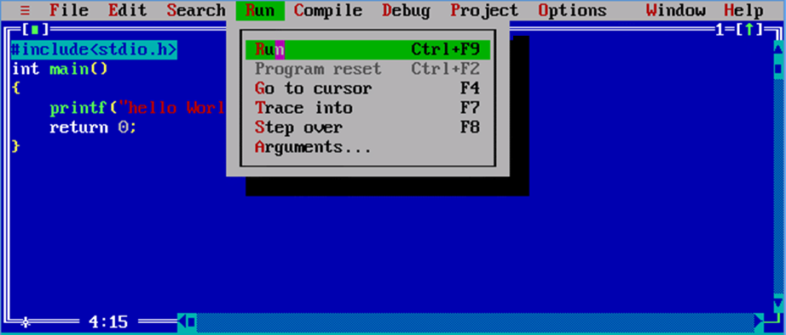
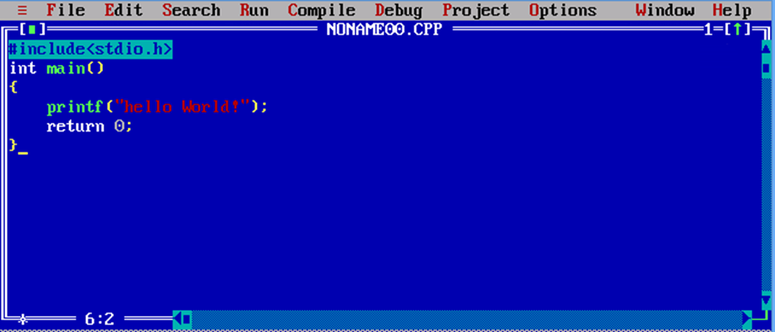
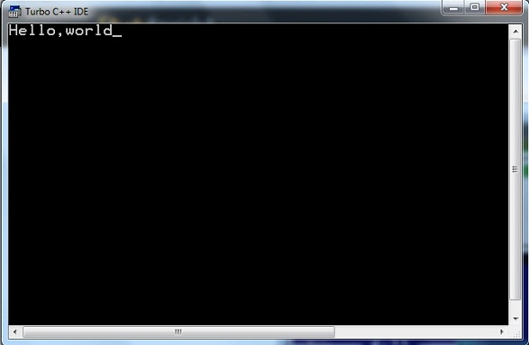
What is Process?
Program
Process

Slide 5
What is Process?
Process is a program under execution.
Process is an abstraction of a running program.
Process is an instance of an executing program, including the current values of the program counter, registers & variables.
Each process has its own virtual CPU.

Slide 6


Multiprogramming
The real CPU switches back and forth from process to process.
This rapid switching back and forth is called multiprogramming.
The number of processes loaded simultaneously in memory is called degree of multiprogramming.

Slide 7


Multiprogramming execution
There are three processes, one processor (CPU), three logical program counter (one for each processes) in memory and one physical program counter in processor.
Here CPU is free (no process is running).
No data in physical program counter.
P1
P2
P3
Memory
Logical
Program Counter
P1
Processor
Logical
Program Counter
Physical
Program Counter
P2
Logical
Program Counter
P3

Slide 8
Multiprogramming execution
CPU is allocated to process P1 (process P1 is running).
Data of process P1 is copied from its logical program counter to the physical program counter.
P1
P2
P3
Memory
Logical
Program Counter
P1
P1
Processor
Logical
Program Counter
Physical
Program Counter
P2
Logical
Program Counter
P3

Slide 9
Multiprogramming execution
CPU switches from process P1 to process P2.
CPU is allocated to process P2 (process P2 is running).
Data of process P1 is copied back to its logical program counter.
Data of process P2 is copied from its logical program counter to the physical program counter.
P1
P2
P3
Memory
Logical
Program Counter
P1
Processor
Logical
Program Counter
P2
Physical
Program Counter
P2
P1
Logical
Program Counter
P3

Slide 10
Multiprogramming execution
CPU switches from process P2 to process P3.
CPU is allocated to process P3 (process P3 is running).
Data of process P2 is copied back its logical program counter.
Data of process P3 is copied from its logical program counter to the physical program counter.
P1
P2
P3
Memory
Logical
Program Counter
P1
Processor
Logical
Program Counter
P2
Physical
Program Counter
P3
P2
Logical
Program Counter
P3

Slide 11
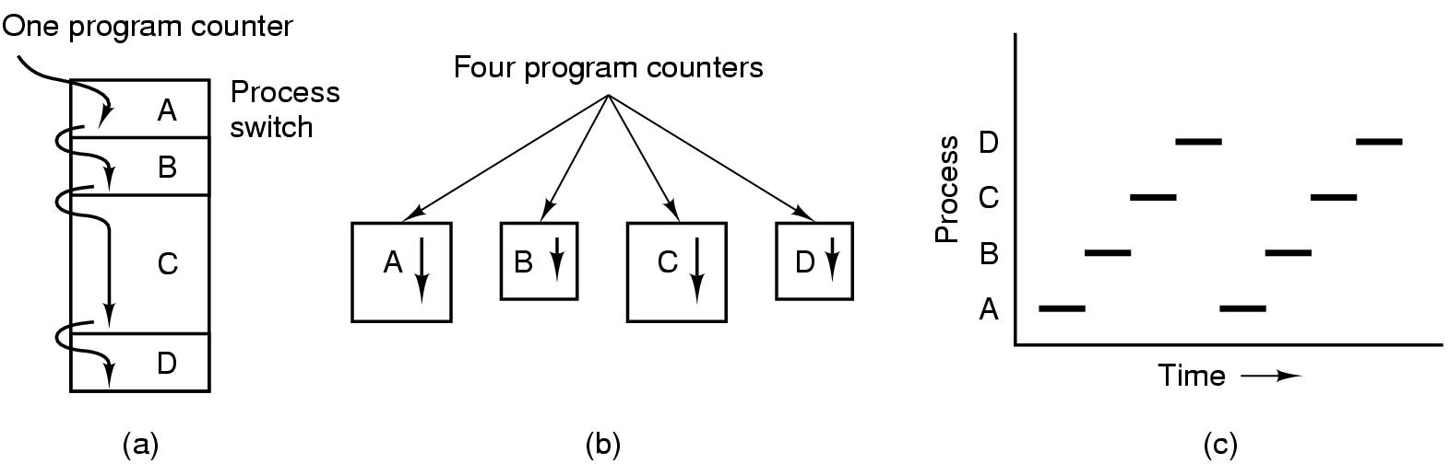
Process Model
Multiprogramming of
four programs in memory
Conceptual model of 4 independent, sequential processes, each with its own flow of control (i.e., its own logical program counter) and each one running independently of the other ones.
Over a long period of time interval, all the processes have made progress, but at any given instant only one process is actually running.

Slide 12

Process Creation
System initialization
At the time of system (OS) booting various processes are created
Foreground and background processes are created
Background process – that do not interact with user e.g. process to accept mail
Foreground Process – that interact with user
Execution of a process creation system call (fork) by running process
Running process will issue system call (fork) to create one or more new process to help it.
A process fetching large amount of data and execute it will create two different processes one for fetching data and another to execute it.
P1
P3
P2

Slide 13

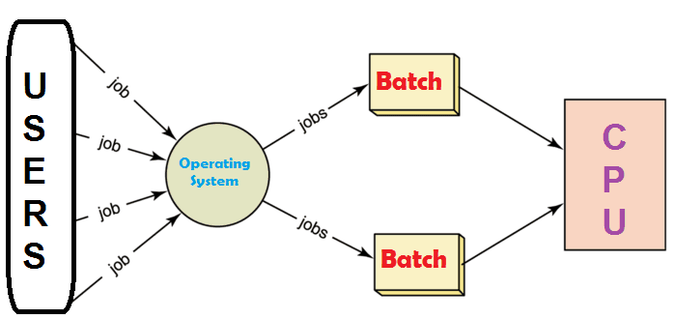
Process Creation
A user request to create a new process
Start process by clicking an icon (opening word file by double click) or by typing command.
Initialization of batch process
Applicable to only batch system found on large mainframe

Slide 14
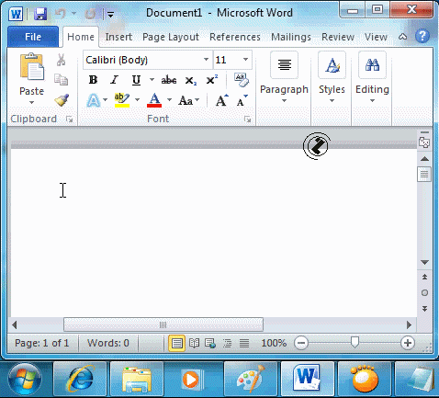
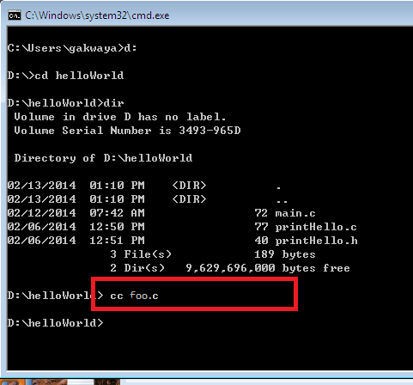

Process Termination
Normal exit (voluntary)
Terminated because process has done its work.
Error exit (voluntary)
The process discovers a fatal error e.g. user types the command cc foo.c to compile the program foo.c and no such file exists, the compiler simply exit.

Slide 15
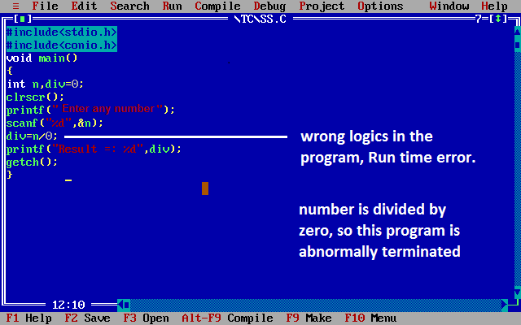

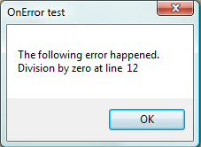
Process Termination
Fatal error (involuntary)
An error caused by a process often due to a program bug e.g. executing an illegal instruction, referencing nonexistent memory or divided by zero.
Killed by another process (involuntary)
A process executes a system call telling the OS to kill some other process using kill system call.

Slide 16
Process Hierarchies
Parent process can create child process, child process can create its own child process.
UNIX has hierarchy concept which is known as process group
Windows has no concept of hierarchy
All the process as treated equal (use handle concept)
P1
Parent process
P2
P4
Child process
P3
P5
P6
P3
Parent process
P5
P6
Child process

Slide 17

Handle
When a process is created, the parent process is given a special token called handle.
This handle is used to control the child process.
A process is free to pass this token to some other process.
P1
Parent process
P2
P4
Child process
P3

Slide 18
Process states
Section - 2

Slide 19



Process states
Running
Running:
Process is actually using the CPU
Ready
Ready:
Process is runnable, temporarily stopped to let another process to run
Blocked
Blocked:
Process is unable to run until some external event happens

Slide 20

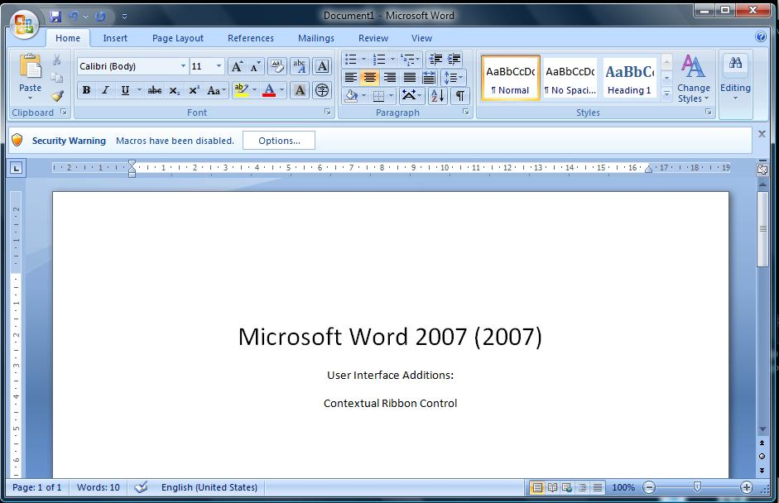

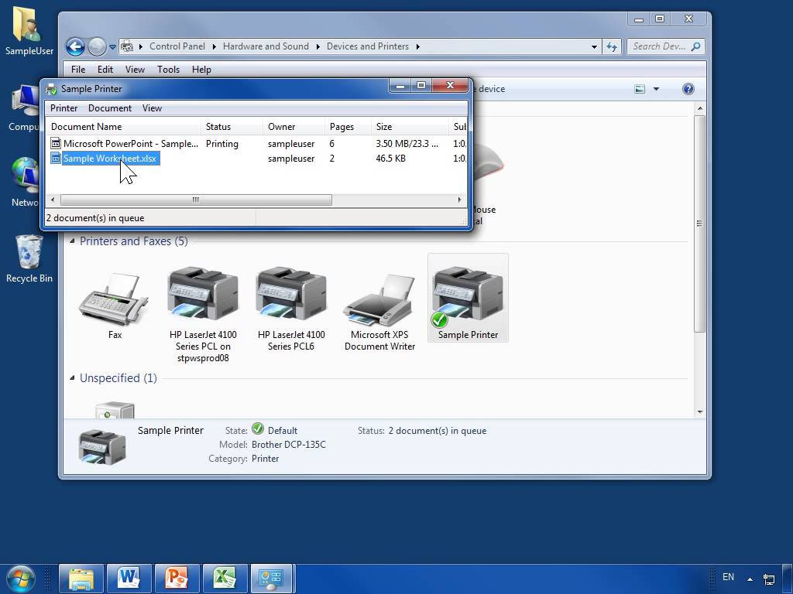
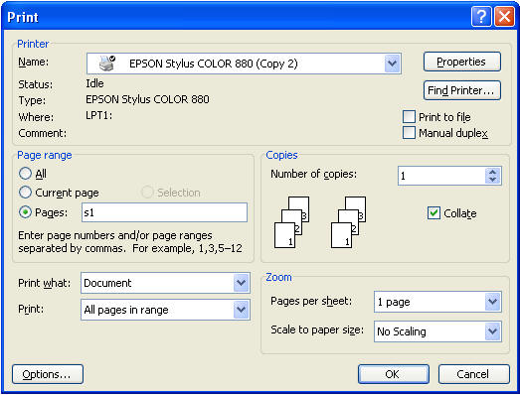

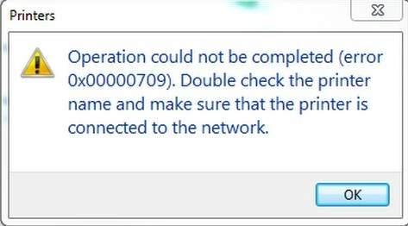
Process states
Blocked
Running
Ready
Running – Process is actually using the CPU
Ready – Process is runnable, temporarily stopped to let another process to run
Blocked – process is unable to run until some external event happens
Processes are always either executing (running), waiting to execute (ready) or waiting for an event (blocked) to occur.
Running
Blocked
Ready

Slide 21
Process states transitions
Section - 3

Slide 22
Process State Transitions
When and how these transitions occur (process moves from one state to another)?
Process blocks for input or waits for an event (i.e. printer is not available)
Scheduler picks another process
End of time-slice or pre-emption.
Scheduler picks this process
Input becomes available, event arrives (i.e. printer become available)
Running
3
1
2
Blocked
Ready
4
Processes are always either executing (running) or waiting to execute (ready) or waiting for an event (blocked) to occur.

Slide 23
Five State Process Model and Transitions
HDD
RAM
RAM
-
New – process is being created
Ready – process is waiting to run (runnable), temporarily stopped to let another process run
Running – process is actually using the CPU
Blocked – unable to run until some external event happens
Exit (Terminated) – process has finished the execution
Admit
Dispatch
Release
New
Ready
Running
Exit
Time-out
Event
Occurs
Event
Wait
Blocked
RAM
Exercise
A process resides in which memory during different state?

Slide 24
Queue Diagram
HDD
RAM
RAM
-
Admit
Dispatch
Release
New
Ready
Running
Exit
Time-out
Event
Occurs
Event
Wait
Process is
Scheduled
to run
Dispatch
Process is
completed
Exit
Blocked
Ready Queue
RAM
Admit
Processor
Time-out
Event Wait
Event
Occurs
Blocked Queue

Slide 25
Five State Process Model and Transitions (Exercise)
A
B
D
New
Ready
Running
Exit
C
In the following process state transition diagram for a uniprocessor system, assume that there are always some processes in the ready state: Now consider the following statements:
E
F
Blocked
I. If a process makes a transition D, it would result in
another process making transition A immediately.
II. A process P2 in blocked state can make transition E
while another process P1 is in running state.
I. (False) If a process makes a transition D, it would result in another process making transition B, not A.
II. (True) A process can move to ready state when I/O completes irrespective of other process being in running state or not.
III. The OS uses preemptive scheduling.
IV. The OS uses non-preemptive scheduling.
III. (True) There is a transition from running to ready state.
IV. (False) as the OS uses preemptive scheduling.

Slide 26
Process Control Block (PCB)
Section - 4

Slide 27

What is Process Control Block (PCB)?
A Process Control Block (PCB) is a data structure maintained by the operating system for every process.
PCB is used for storing the collection of information about the processes.
The PCB is identified by an integer process ID (PID).
A PCB keeps all the information needed to keep track of a process.
The PCB is maintained for a process throughout its lifetime and is deleted once the process terminates.
The architecture of a PCB is completely dependent on operating system and may contain different information in different operating systems.
PCB lies in kernel memory space.

Slide 28
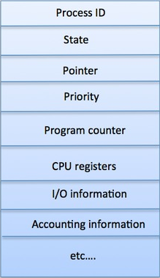
Fields of Process Control Block (PCB)
Process ID - Unique identification for each of the process in the operating system.
Process State - The current state of the process i.e., whether it is ready, running, waiting.
Pointer - A pointer to parent process.
Priority - Priority of a process.
Program Counter - Program Counter is a pointer to the address of the next instruction to be executed for this process.
CPU registers - Various CPU registers where process need to be stored for execution for running state.
IO status information - This includes a list of I/O devices allocated to the process.
Accounting information - This includes the amount of CPU used for process execution, time limits etc.

Slide 29
Context switching
Section - 5

Slide 30
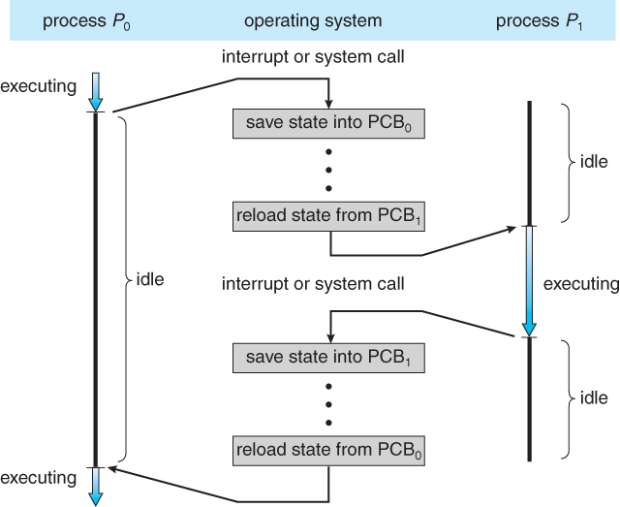
Context switching
Context switch means stopping one process and restarting another process.
When an event occur, the OS saves the state of an active process (into its PCB) and restore the state of new process (from its PCB).
Context switching is purely overhead because system does not perform any useful work while context switch.
Sequence of action:
OS takes control (through interrupt)
Saves context of running process in the process PCB
Reload context of new process from the new process PCB
Return control to new process
Time slice has elapsed
Process with a higher priority has become ready to run.
Exercise
What causes (Reasons for) context switching?

Slide 31
Threads
Section - 6

Slide 32
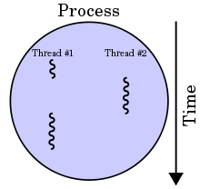

What is Threads?
Thread is light weight process created by a process.
Processes are used to execute large, ‘heavyweight’ jobs such as working in word, while threads are used to carry out smaller or ‘lightweight’ jobs such as auto saving a word document.
Threads

Slide 33
What is Threads?
Thread is light weight process created by a process.
Thread is a single sequence stream within a process.
Thread has it own
program counter that keeps track of which instruction to execute next.
system registers which hold its current working variables.
stack which contains the execution history.

Slide 34
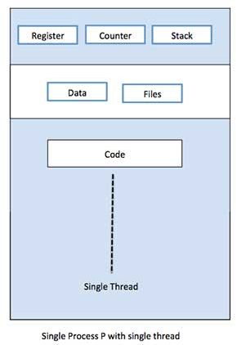
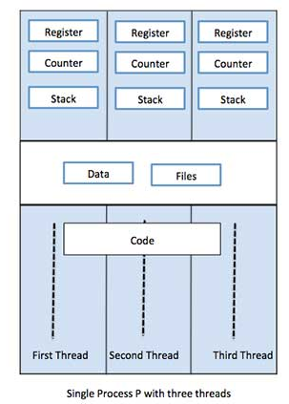
Single Threaded Process VS Multiple Threaded Process
A single-threaded process is a process with a single thread.
A multi-threaded process is a process with multiple threads.
The multiple threads have its own registers, stack and counter but they share the code and data segment.

Slide 35
Comparison between process and thread
Section - 7

Slide 36
Similarities between Process & Thread
Like processes threads share CPU and only one thread is running at a time.
Like processes threads within a process execute sequentially.
Like processes thread can create children's.
Like a traditional process, a thread can be in any one of several states: running, blocked, ready or terminated.
Like process threads have Program Counter, Stack, Registers and State.

Slide 37
Dissimilarities between Process & Thread
Unlike processes threads are not independent of one another.
Threads within the same process share an address space.
Unlike processes all threads can access every address in the task.
Unlike processes threads are design to assist one other. Note that processes might or might not assist one another because processes may be originated from different users.

Slide 38
Benefits/Advantages of threads
Section - 8

Slide 39
Benefits/Advantages of Threads
Threads minimize the context switching time.
Use of threads provides concurrency within a process.
Efficient communication.
It is more easy to create and context switch threads.
Threads can execute in parallel on multiprocessors.
With threads, an application can avoid per-process overheads
Thread creation, deletion, switching easier than processes.
Threads have full access to address space (easy sharing).

Slide 40
Types of threads
Section - 9

Slide 41
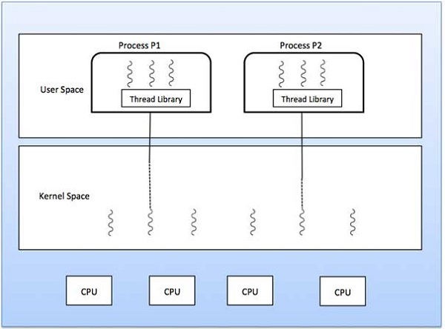
Types of Threads
Kernel Level Thread
User Level Thread
User
Level
Threads
Kernel
Level
Threads

Slide 42
Types of Threads
User Level Thread | Kernel Level Thread
User thread are implemented by users. | Kernel threads are implemented by OS.
OS doesn’t recognize user level threads. | Kernel threads are recognized by OS.
Implementation of user threads is easy. | Implementation of kernel thread is complex.
Context switch time is less. | Context switch time is more.
Context switch requires no hardware support. | Context switch requires hardware support.
If one user level thread perform blocking operation then entire process will be blocked. | If one kernel thread perform blocking operation then another thread with in same process can continue execution.
Example : Java thread, POSIX threads. | Example : Window Solaris

Slide 43
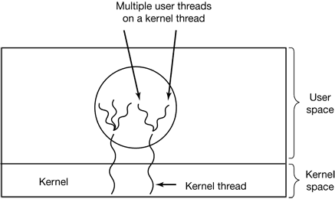
Hybrid Threads
Combines the advantages of user level and kernel level thread.
It uses kernel level thread and then multiplex user level thread on to some or all of kernel threads.
Gives flexibility to programmer that how many kernel level threads to use and how many user level thread to multiplex on each one.
Kernel is aware of only kernel level threads and schedule it.

Slide 44
Multi Threading Models
Section - 10

Slide 45
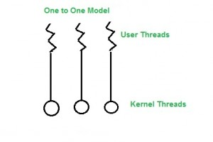
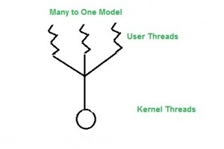
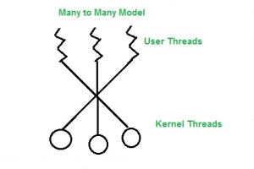
Multi Threading Models
One to One Model
Each user threads mapped to one kernel thread.
Problem with this model is that creating a user thread requires the corresponding kernel thread.
Many to One Model
Multiple user threads mapped to one kernel thread.
Problem with this model is that a user thread can block entire process because we have only one kernel thread.
Many to Many Model
Multiple user threads multiplex to more than one kernel threads.
Advantage with this model is that a user thread can not block entire process because we have multiple kernel thread.

Slide 46
IMP Questions
Explain Process/Thread Life Cycle with diagram.
Explain process control block (PCB) with diagram.
Difference between process and thread.
Write various multi threading models.
Write benefits of threads.

Slide 47

Looping
Outline (Process Scheduling)
What is scheduling
Objectives of scheduling
Types of scheduler
Scheduling algorithms
First Come First Served (FCFS)
Shortest Job First (SJF)
Shortest Remaining Time Next (SRTN)
Round Robin (RR)
Priority
Non-Preemptive Priority
Preemptive Priority

Slide 48
What is process scheduling?
Section - 1

Slide 49

What is process scheduling?
Process scheduling is the activity of the process manager that handles suspension of running process from CPU and selection of another process on the basis of a particular strategy.
The part of operating system that makes the choice is called scheduler.
The algorithm used by this scheduler is called scheduling algorithm.
Process scheduling is an essential part of a multiprogramming operating systems.

Slide 50
Objectives (goals) of scheduling
Section - 2

Slide 51
Objectives (goals) of scheduling
Fairness: giving each process a fair share of the CPU.
Balance: keeping all the parts of the system busy (Maximize).
Throughput: no of processes that are completed per time unit (Maximize).
Turnaround time: time to execute a process from submission to completion (Minimize).
Turnaround time = Process finish time – Process arrival time
CPU utilization: percent of time that the CPU is busy in executing a process.
keep CPU as busy as possible (Maximized).
Response time: time between issuing a command and getting the result (Minimized).
Waiting time: amount of time a process has been waiting in the ready queue (Minimize).
Waiting time = Turnaround time – Actual execution time

Slide 52
Types of schedulers
Section - 3

Slide 53
Types of schedulers
Long Term
Scheduler
Short Term
Scheduler
Ready Queue
Admit
Dispatch
Exit
Processor
Medium Term
Scheduler
Time-out
Event Wait
Event
Occurs
Blocked Queue

Slide 54
Types of schedulers
Long-Term Scheduler | Short-Term Scheduler | Medium-Term Scheduler
It is a job scheduler. | It is a CPU scheduler. | It is a process swapping scheduler.
It selects processes from pool and loads them into memory for execution. | It selects those processes which are ready to execute. | It can re-introduce the process into memory and execution can be continued.
Speed is lesser than short term scheduler. | Speed is fastest among other two schedulers. | Speed is in between both short and long term scheduler.
It is almost absent or minimal in time sharing system. | It is also minimal in time sharing system. | It is a part of time sharing systems.

Slide 55
Scheduling algorithms
Section - 4

Slide 56
Scheduling algorithms
First Come First Served (FCFS)
Shortest Job First (SJF)
Shortest Remaining Time Next (SRTN)
Round Robin (RR)
Priority
Preemptive
Non-Preemptive

Slide 57
First Come First Served (FCFS)
Section – 4.1

Slide 58

First Come First Served (FCFS)
Selection criteria:
The process that request first is served first.
It means that processes are served in the exact order of their arrival.
Decision Mode:
Non preemptive: Once a process is selected, it runs until it is blocked for an I/O or some other event or it is terminated.
Implementation:
This strategy can be easily implemented by using FIFO (First In First Out) queue.
When CPU becomes free, a process from the first position in a queue is selected to run.
Ready queue
P0
Head
P1
P2
Tail
P3

Slide 59
First Come First Served (FCFS)
Gantt Chart
Average Turnaround Time: (10+15+15+17)/4 = 14.25 ms.
Average Waiting Time: (0+9+13+13)/4 = 8.75 ms.
Process | Arrival Time (T0) | Burst Time (ΔT)
P0 | 0 | 10
P1 | 1 | 6
P2 | 3 | 2
P3 | 5 | 4
Finish Time (T1)
Turnaround Time (TAT = T1 - T0)
Waiting Time (WT = TAT - ΔT)
10
10
0
16
15
9
18
15
13
22
17
13
P0
P1
P2
P3
0
10
16
18
22

Slide 60
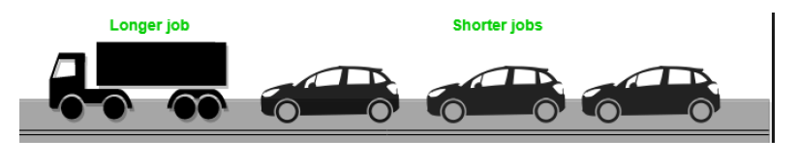
First Come First Served (FCFS)
Advantages
Simple and fair.
Easy to understand and implement.
Every process will get a chance to run, so starvation doesn't occur.
Starvation is the problem that occurs when high priority processes keep executing and low priority processes get blocked for indefinite time.
Disadvantages
Not efficient because average waiting time is too high.
Convoy effect is possible. All small I/O bound processes wait for one big CPU bound process to acquire CPU.

Slide 61
Shortest Job First (SJF)
Section – 4.2

Slide 62
Shortest Job First (SJF)
Selection criteria:
The process, that requires shortest time to complete execution, is served first.
Decision Mode:
Non preemptive: Once a process is selected, it runs until it is blocked for an I/O or some other event or it is terminated.
Implementation:
This strategy can be easily implemented by using sorted FIFO (First In First Out) queue.
All processes in a queue are sorted in ascending order based on their required CPU bursts.
When CPU becomes free, a process from the first position in a queue is selected to run.
Ready queue
P0 (4)
Head
P1 (2)
P2 (6)
Tail
P3 (3)

Slide 63
Shortest Job First (SJF)
Gantt Chart
Average Turnaround Time: (10+21+9+11)/4 = 12.75 ms.
Average Waiting Time: (0+15+7+7)/4 = 7.25 ms.
Process | Arrival Time (T0) | Burst Time (ΔT)
P0 | 0 | 10
P1 | 1 | 6
P2 | 3 | 2
P3 | 5 | 4
Finish Time (T1)
Turnaround Time (TAT = T1 - T0)
Waiting Time (WT = TAT - ΔT)
10
10
0
22
21
15
12
9
7
16
11
7
P0
P2
P3
P1
0
10
12
16
22

Slide 64
Shortest Job First (SJF)
Advantages
Less waiting time.
Good response for short processes.
Disadvantages
It is difficult to estimate time required to complete execution.
Starvation is possible for long process. Long process may wait forever.
Starvation is the problem that occurs when high priority processes keep executing and low priority processes get blocked for indefinite time.

Slide 65
Shortest Remaining Time Next (SRTN)
Section – 4.3

Slide 66
Shortest Remaining Time Next (SRTN)
Selection criteria:
The process, whose remaining run time is shortest, is served first. This is a preemptive version of SJF scheduling.
Decision Mode:
Preemptive: When a new process arrives, its total time is compared to the current process remaining run time.
If the new process needs less time to finish than the current process, the current process is suspended and the new job is started.
Implementation:
This strategy can also be implemented by using sorted FIFO queue.
All processes in a queue are sorted in ascending order on their remaining run time.
When CPU becomes free, a process from the first position in a queue is selected to run.
Ready queue
P0 (2)
Head
P1 (2)
P2 (6)
Tail
P3 (1)

Slide 67
Shortest Remaining Time Next (SRTN)
Gantt Chart
Average Turnaround Time: 10 ms
Average Waiting Time: 4.5 ms
Process | Arrival Time (T0) | Burst Time (ΔT)
P0 | 0 | 10
P1 | 1 | 6
P2 | 3 | 2
P3 | 5 | 4
Finish Time (T1)
Turnaround Time (TAT = T1 - T0)
Waiting Time (WT = TAT - ΔT)
22
22
12
9
8
2
5
2
0
13
8
4
P0
P1
P2
P1
P3
P0
0
1
3
5
9
13
22
Process | Remaining Time
P1 | 6
P0 | 9
Process | Remaining Time
P0 | 9
P1 | 4
P3 | 4
Process | Remaining Time
P0 | 9
P2 | 2
P1 | 4
Process | Remaining Time
P0 | 9
P3 | 4
Process | Remaining Time
P0 | 9

Slide 68
Shortest Remaining Time Next (SRTN)
Advantages
Less waiting time.
Quite good response for short processes.
Disadvantages
It is difficult to estimate time required to complete execution.
Starvation is possible for long process. Long process may wait forever.
Starvation is the problem that occurs when high priority processes keep executing and low priority processes get blocked for indefinite time.
Context switch overhead is there.

Slide 69
Round Robin (RR)
Section – 4.4

Slide 70
Round Robin (RR)
Selection criteria:
Each selected process is assigned a time interval, called time quantum or time slice.
Process is allowed to run only for this time interval.
Here, two things are possible:
First, process is either blocked or terminated before the quantum has elapsed. In this case the CPU switching is done and another process is scheduled to run.
Second, process needs CPU burst longer than time quantum. In this case, process is running at the end of the time quantum.
Now, it will be preempted and moved to the end of the queue.
CPU will be allocated to another process.
Here, length of time quantum is critical to determine.
Ready queue & Quantum = 3
P0 (2)
Head
P1 (2)
P2 (6)
Tail
P3 (1)
Ready queue & Quantum = 3
Ready queue & Quantum = 3
P0 (1)
Head
Tail
P0 (4)
P1 (2)
P2 (6)
P3 (1)

Slide 71
Round Robin (RR)
Decision Mode:
Preemptive: When a new process arrives, its total time is compared to the current process remaining run time.
Selection of new job is as per FCFS scheduling algorithm.
Implementation:
This strategy can be implemented by using circular FIFO queue.
If any process comes, or process releases CPU, or process is preempted. It is moved to the end of the queue.
When CPU becomes free, a process from the first position in a queue is selected to run.

Slide 72
Round Robin (RR)
Process | Arrival Time (T0) | Burst Time (ΔT)
P0 | 0 | 10
P1 | 1 | 6
P2 | 3 | 2
P3 | 5 | 4
Finish Time (T1)
Turnaround Time (TAT = T1 - T0)
Waiting Time (WT = TAT - ΔT)
Gantt Chart
Quantum time is 4 ms &
Context switch overhead is 1 ms
Avg. Turnaround Time: 19.5 ms
Avg. Waiting Time: 14 ms
28
28
18
25
24
18
12
9
7
22
17
13
P0
P1
P2
P0
P3
P1
P0
0
4
5
9
10
12
13
17
18
22
23
25
26
28
Process | Remaining Time
P1 | 6
P2 | 2
P0 | 6
Process | Remaining Time
P2 | 2
P0 | 6
P3 | 4
P1 | 2
Process | Remaining Time
P0 | 6
P3 | 4
P1 | 2
Process | Remaining Time
P3 | 4
P1 | 2
P0 | 2
Process | Remaining Time
P1 | 2
P0 | 2
Process | Remaining Time
P0 | 2

Slide 73
Round Robin (RR)
Advantages
Simplest, fairest and most widely used algorithms.
Disadvantages
Context switch overhead is there.
Determination of time quantum is too critical.
If it is too short, it causes frequent context switches and lowers CPU efficiency.
If it is too long, it causes poor response for short interactive process.

Slide 74
Priority (Non-Preemptive Priority)
Section – 4.5.1

Slide 75
Non-Preemptive Priority
Selection criteria:
The process, that has highest priority, is served first.
Decision Mode:
Non preemptive: Once a process is selected, it runs until it is blocked for an I/O or some other event or it is terminated.
Implementation:
This strategy can also be implemented by using sorted FIFO queue.
All processes in a queue are sorted based on their priority with highest priority process at front end.
When CPU becomes free, a process from the first position in a queue is selected to run.
Ready queue
P0 (2)
Head
P1 (8)
P2 (6)
Tail
P3 (7)

Slide 76
Non-Preemptive Priority
Process | Arrival Time (T0) | Burst Time (ΔT) | Priority
P0 | 0 | 10 | 5
P1 | 1 | 6 | 4
P2 | 3 | 2 | 2
P3 | 5 | 4 | 0
Finish Time (T1)
Turnaround Time (TAT = T1 - T0)
Waiting Time (WT = TAT - ΔT)
Gantt Chart (small values for priority means higher priority of a process)
Avg. Turnaround Time: 13.25 ms
Avg. Waiting Time: 7.75 ms
10
10
0
22
21
15
16
13
11
14
9
5
P0
P3
P2
P1
0
10
14
16
22

Slide 77
Non-Preemptive Priority
Advantages
Priority is considered so critical processes can get even better response time.
Disadvantages
Starvation is possible for low priority processes. It can be overcome by using technique called ‘Aging’.
Aging: gradually increases the priority of processes that wait in the system for a long time.

Slide 78
Priority (Preemptive Priority)
Section – 4.5.2

Slide 79
Preemptive Priority
Selection criteria:
The process, that has highest priority, is served first.
Decision Mode:
Preemptive: When a new process arrives, its priority is compared with current process priority.
If the new process has higher priority than the current, the current process is suspended and new job is started.
Implementation:
This strategy can also be implemented by using sorted FIFO queue.
All processes in a queue are sorted based on their priority with highest priority process at front end.
When CPU becomes free, a process from the first position in a queue is selected to run.
Ready queue
P0 (7)
Head
P1 (5)
P2 (4)
Tail
P3 (8)

Slide 80
Preemptive Priority
Process | Arrival Time (T0) | Burst Time (ΔT) | Priority
P0 | 0 | 10 | 5
P1 | 1 | 6 | 4
P2 | 3 | 2 | 2
P3 | 5 | 4 | 0
Finish Time (T1)
Turnaround Time (TAT = T1 - T0)
Waiting Time (WT = TAT - ΔT)
Gantt Chart
small values means higher priority
Avg. Turnaround Time: 10 ms
Avg. Waiting Time: 4.5 ms
22
22
12
13
12
6
5
2
0
9
4
0
P0
P1
P2
P3
P1
P0
0
1
3
5
9
13
22
Process | Priority
P1 | 4
P0 | 5
Process | Priority
P0 | 5
P2 | 2
P1 | 4
Process | Priority
P0 | 5
P1 | 4
P3 | 0
Process | Priority
P0 | 5
P1 | 4
Process | Priority
P0 | 5

Slide 81
Preemptive Priority
Advantages
Priority is considered so critical processes can get even better response time.
Disadvantages
Starvation is possible for low priority processes. It can be overcome by using technique called ‘Aging’.
Aging: gradually increases the priority of processes that wait in the system for a long time.
Context switch overhead is there.

Slide 82
Exercise
Five batch jobs A to E arrive at same time. They have estimated running times 10,6,2,4 and 8 minutes. Their priorities are 3,5,2,1 and 4 respectively with 5 being highest priority. For each of the following algorithm determine mean process turnaround time. Ignore process swapping overhead. Quantum time is 2 minute.
Round Robin, Priority Scheduling, FCFS, SJF.
Suppose that the following processes arrive for the execution at the times indicated. Each process will run the listed amount of time. Assume preemptive scheduling.
Process Arrival Time (ms) Burst Time (ms)
P1 0.0 8
P2 0.4 4
P3 1.0 1
What is the turnaround time for these processes with Shortest Job First scheduling algorithm?

Slide 83
Exercise
Consider the following set of processes with length of CPU burst time given in milliseconds.
Process Burst Time Priority
P1 10 3
P2 1 1
P3 2 3
P4 1 4
P5 5 2
Assume arrival order is: P1, P2, P3, P4, P5 all at time 0 and a smaller priority number implies a higher priority. Draw the Gantt charts illustrating the execution of these processes using preemptive priority scheduling.

Slide 84
Exercise
Consider three processes P1, P2 and P3 with arrival time of 0,1 and 2 time units respectively, and total execution time of 20, 30 and 40 units respectively. Each process spends the first 30% of execution time doing I/O, then next 60% doing CPU and remaining 10% time doing I/O again. The operating uses a First come first serve scheduling algorithm and schedules a new process either when the running process gets blocked on I/O or when the running process finishes its compute burst. For what percentage of time does the CPU remain idle? (Ans. 15.62%)
Consider three processes (process id 0, 1, 2 respectively) with compute time bursts 2, 4 and 8 time units. All processes arrive at time zero. Consider the longest remaining time first (LRTF) scheduling algorithm. In LRTF ties are broken by giving priority to the process with the lowest process id. Calculate average turn around time. (Ans. 13)
idle
P1
P2
P3
idle
0
6
18
36
60
64
P2
P1
P2
P1
P2
P0
P1
P2
P0
P1
P2
0
4
5
6
7
8
9
10
11
12
13
14

Slide 85
Exercise
Consider four processes P,Q,R,S scheduled on a as per round robin algorithm with a time quantum of 4 Unit. The processes arrive in the order P,Q,R,S all at time t=0.
There is exactly one context switch from S to Q
and exactly one context switch from R to Q
and exactly two context switches from Q to R
There is no context switch from S to P
Switching to a ready process after the termination of another process is also considered a context switch. Which one of the following is NOT possible as burst time of these processes?
A) P=4, Q=10, R=6, S=2
B) P=2, Q=9, R=5, S=1
C) P=3, Q=7, R=7, S=3
P
Q
R
S
Q
R
Q
Find burst time
P = Between 1 and 4
Q = Between 9 and 12
R = Between 5 and 8
S = Between 1 and 4

Slide 86
IMP Questions
Define term Scheduler, Scheduling and Scheduling Algorithm with example.
Define terms. 1) Throughput 2) Waiting Time 3) Turnaround Time 4) Response Time 5) Granularity 6) Short Term Scheduler 7) CPU Utilization
What is scheduler? Explain queuing diagram representation of process scheduler with figure.
Consider Five Processes P1 to P5 arrived at same time. They have estimated running time 10, 2, 6, 8 and 4 seconds, respectively. Their Priorities are 3, 2, 5, 4 and 1, respectively with 5 being highest Priority. Find the average turnaround time and average waiting time for Round Robin (quantum time=3) and Priority Scheduling algorithm.
Consider the processes P1, P2, P3, P4 with burst time is 21, 3, 6 and 2 respectively, arrives for execution in the same order, with arrival time 0, draw GANTT chart and find the average waiting time using the FCFS and SJF scheduling algorithm.

Slide 87
Operating Systems (OS)
2301CS601
Prof. Firoz A Sherasiya
Computer Engineering Department
firoz.sherasiya@darshan.ac.in
9879879861

